Slide 1


Lightning
Five SQL Server settings you never touched, but probably should!
Enrico van de Laar
Talk

Slide 2

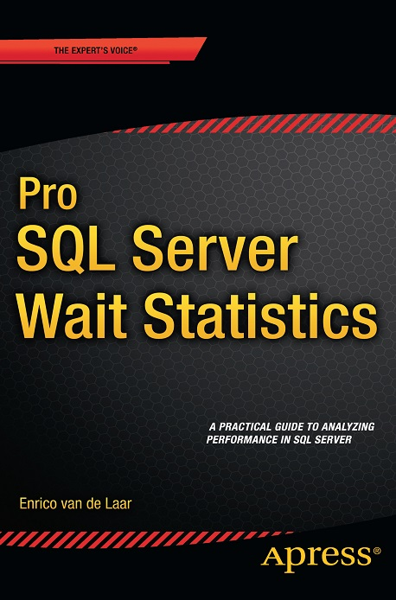
Introduction
Enrico van de Laar
Microsoft SQL Server MVP
Database Technology Specialist
Blogger
Author

Slide 3
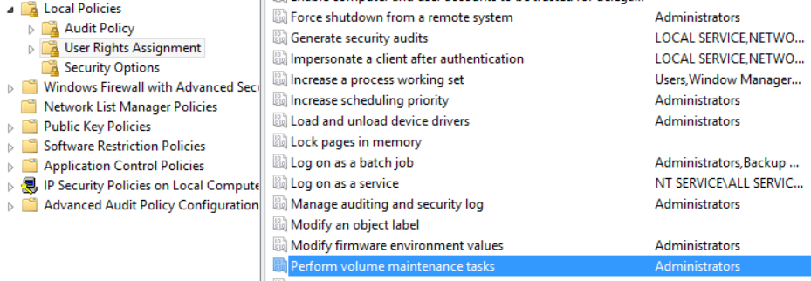
Number I – Instant File Initialization
What?
Instant File Initialization removes the need to fill data files with 0’s before they can be used
Adding the SQL Server Service account to the policy will dramatically speed up database creation, backup and restore
Where?
Local Policy – User Right Assignment – Perform Volume Maintenance Tasks

Slide 4
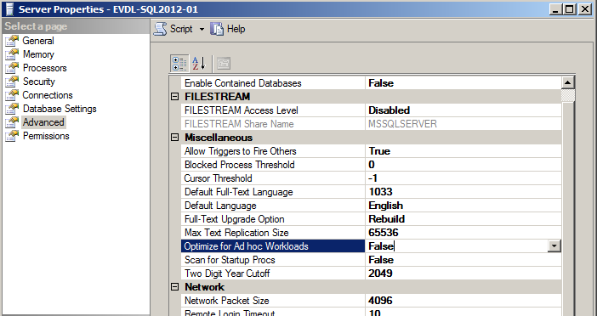
Number II – Optimize for ad hoc workloads
What?
Optimize for ad hoc workloads creates a stub when an Execution Plan is first compiled instead of saving the entire Execution Plan to the Plan Cache
This can save a lot of memory if your workload consists of many ad hoc queries
Where?
Instance Properties – Advanced – Optimize for Ad hoc Workloads

Slide 5
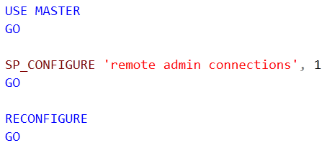
Number III – Dedicated Admin Connection
What?
The Dedicated Admin Connection (DAC) will make it possible to connect to your SQL Server Instance when it is unresponsive
The DAC has it’s own scheduler and threads available, giving you a way to troubleshoot when no user threads are available
Where?
T-SQL:

Slide 6

Number IV – Max Degree of Parallelism
What?
Max Degree of Parallelism determines if parallelism can be used by queries, and how many logical processors can get used in a parallel operation
Default of “0” means every logical processor can be used in parallel operations
You don’t always want parallelism to occur…
Where?
Instance Properties – Advanced – Max Degree of Parallelism

Slide 7

Number V – Cost Threshold for Parallelism
What?
Cost threshold for Parallelism determines the how high the query execution cost should be for SQL Server to considerate running the query using parallelism
To low value and everything will run using parallelism, to high and every will be executed serially
Where?
Instance Properties – Advanced – Cost Threshold for Parallelism

Slide 8
Lightning
The End
Talk

